Slide 1
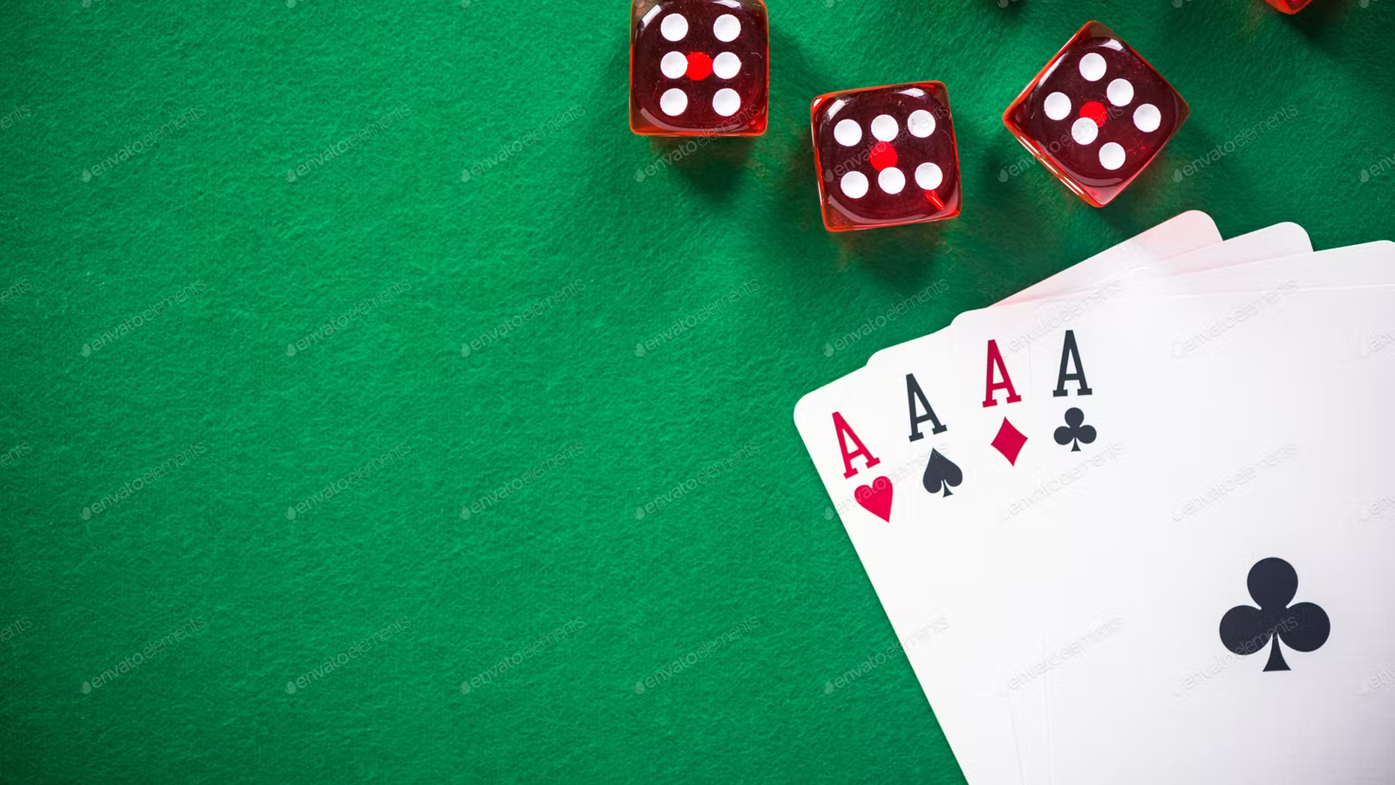
TEAM X’s
SOLITAIRE
Ana Rosa, Brook, Kelly & Zamzam

Slide 2
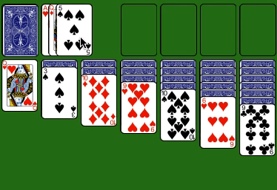
INTRODUCTION
As we all know, Solitaire is a card game that is only played with the objective of using up all ones cards to form particular arrangements and sequences.
BASIC OBJECTIVES:
“The first objective is to release and play into position certain cards to build up each foundation, in sequence and in suit, from the ace through the king. The ultimate objective is to build the whole pack onto the foundations, and if that can be done, the Solitaire game is won.” - Bicycle Cards

Slide 3
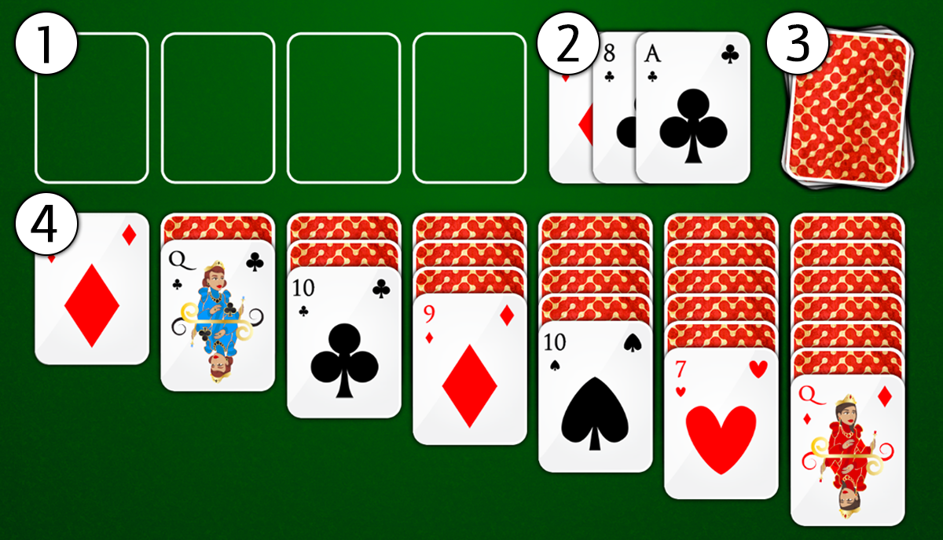
WORK COMPLETED
Card Superclass
- Class that holds the characteristics of a playing card (Suit, Rank and Image)
Cardpile Class
-Virtual representation of the full deck of 64 cards and smaller piles of cards.
Discard Pile Class [2]
-Cards are face up on the discard pile.
[Preview with face-up cards.]
Deck Pile Class [3]
-Shuffles cards.
-Cards are face down.

Slide 4
GROUP EVALUATION
CHALLENGES AND RESOLUTIONS
-Time Management: Throughout the semester, this was probably our biggest challenge as our schedules really don’t match very well. This would result in meetings were not everyone could come and then got cancelled.
-Communication: There was a lack of communication on the periods of time that were far from a deadline, which also affected our time management.
-A lot of the group members were very busy and did not have time to work on the project as they would have liked.
WHAT WENT WELL
-Even though there were many challenges, In the beginning things were going okay and it seemed like we had created a good plan on how we were gonna complete the project. It was at the end that were most of the group members became extremely busy and the challenges became bigger.
IMPROVEMENTS
-For future projects, it would be great to establish better communication between the group and make sure to try to start earlier. Maybe individual members can get started on small stuff and build up on it once together.

Slide 5
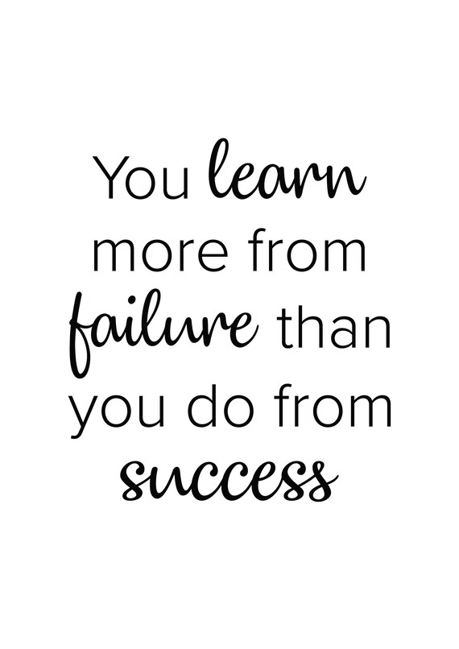
CONCLUSION
We learned that it is ok to make some changes (or even many) to another member’s work in order for both parts to successfully work together.
Even if the project wasn’t finished we all learned a little bit more about what a group project entails, and will probably have this experience in mind when we have similar projects in the future.
Inspirational quote

